Slide 1

GlassVAC

Slide 2

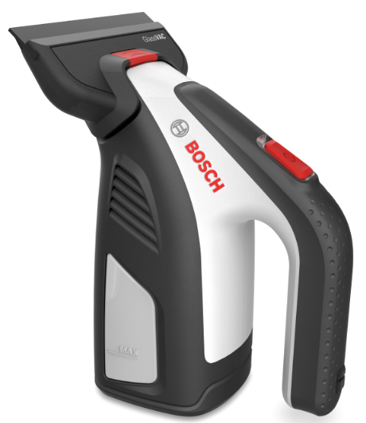
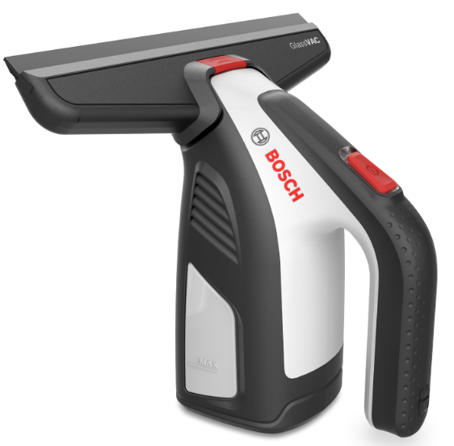
1.1 Beneficii & Caracteristici
Cap usor detasabil
Stergator Bosch
Posibilitatea de schimbare a duzei de aspiratie pentru diferite utilizari.
Power Protection Plus, invelis din cauciuc ce inlatura orice urma lasata.
Indicatori LED
Indicator LED rosu si verde ce indica utilizarea si nivelul de incarcare.
Usor de manevrat
30% mai compact in comparatie cuprodusele competitoare.
Manseta atasabila
Incarcator Micro-USB
Pentru siguranta si confortul in timpul utilizarii.
Timp de incarcare: 3 ore
2
PT-HG/PXW | 21/09/2017
© Robert Bosch GmbH 2017. All rights reserved, also regarding any disposal, exploitation, reproduction, editing, distribution, as well as in the event of applications for industrial property rights.

Slide 3
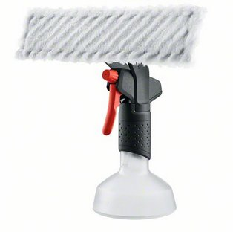
1.2 Beneficii & Caracteristici
Tesatura din microfibra
Tesatura din microfibra rezistenta la murdarie. Poate fi spalata la masina.
Duza de pulverizare (ajustabila)
Duza ajustabila in functie de dimensiunea suprafetei curatate.
Maner ergonomic
Confortabil la manevrare
Baza stabila
Pentru prevenirea caderii
3
PT-HG/PXW | 21/09/2017
© Robert Bosch GmbH 2017. All rights reserved, also regarding any disposal, exploitation, reproduction, editing, distribution, as well as in the event of applications for industrial property rights.

Slide 4
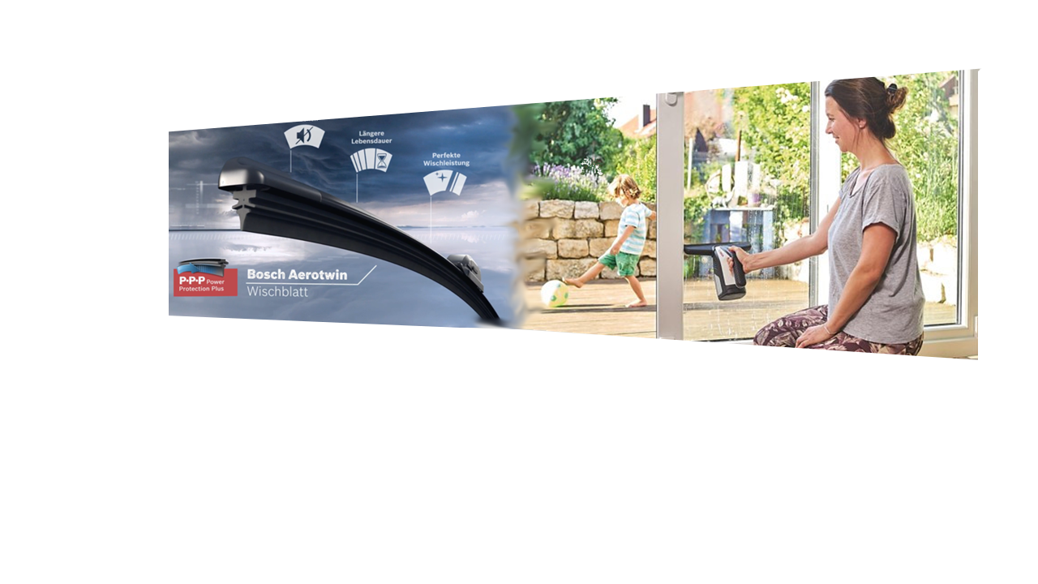

Stergator utilizat si in tehnologia automotive Bosch
1.3 Beneficii & Caracteristici
Utilizeaza expertiza Bosch din sectorul automotive
“Power Protection Plus”: inovatie patentata cu tehnologia stergatoarelor Bosch cu invelis din polimeri
Avantaje:
Invelisul din cauciuc permite o alunecare usoara pe suprafata din sticla, cu rezultate rapide
Lamela robusta si durabila
Curatare fara urme lasate pe suprafetele curatate
Fara zgomote stridente, chiar si pe suprafetele uscate
4
PT-HG/PXW | 21/09/2017
© Robert Bosch GmbH 2017. All rights reserved, also regarding any disposal, exploitation, reproduction, editing, distribution, as well as in the event of applications for industrial property rights.

Slide 5
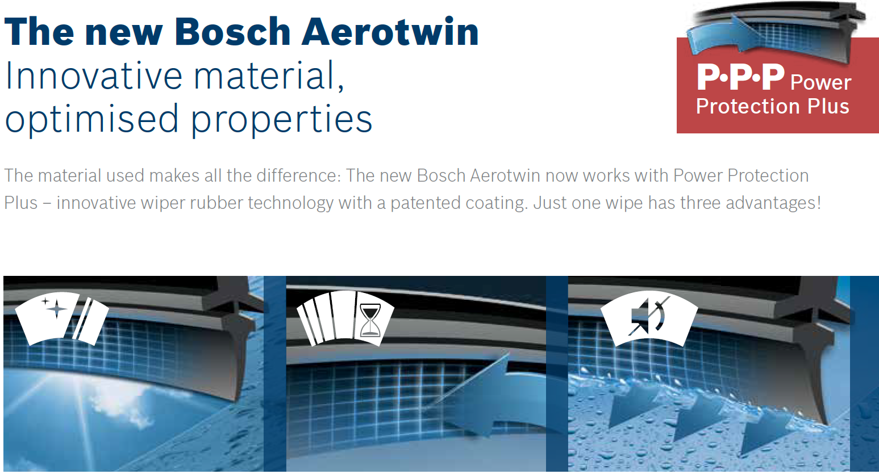





Tehnologie Aerotwin Bosch
1.4 Beneficii & Caracteristici
Beneficii ale tehnologiei Power Protection Plus
Invelis patentat | Curatare optima Nu lasa urma pe suprafetele curatate
Design inovator | Performanta unica a curatarii Rezultate constatate pe tot ciclul de viata
Cauciuc rezistent | Ciclul de viata al produsului prelungit cu 25% Lamela foarte rezistenta
Frictiunare minima | Niveluri de zgomot joase Control mai bun in timpul curatarii
Prietenos cu mediul inconjurator | Stergator ecologic Productie sustenabila pentru mediul inconjurator
5
PT-HG/PXW | 21/09/2017
© Robert Bosch GmbH 2017. All rights reserved, also regarding any disposal, exploitation, reproduction, editing, distribution, as well as in the event of applications for industrial property rights.

Slide 6
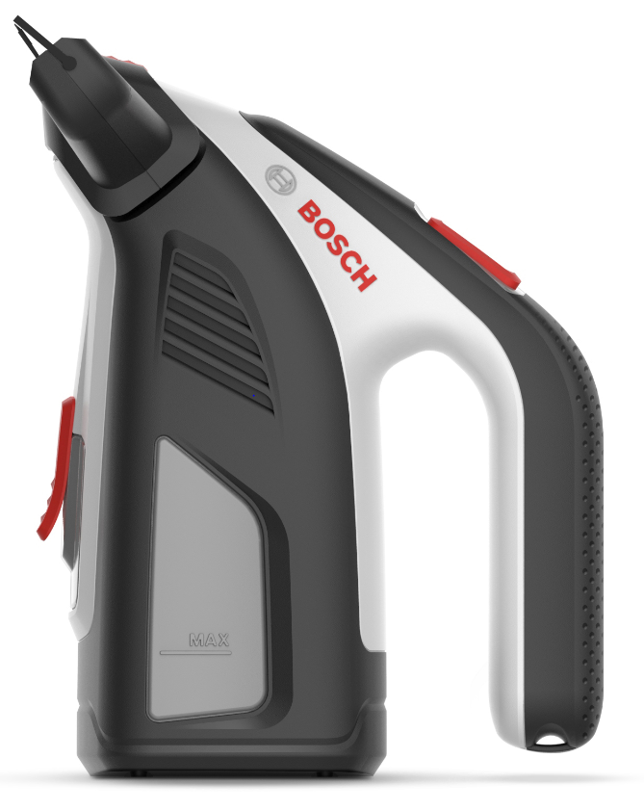
2. Specificatii
Baterie | 3.6V Lithium Ion
Incarcator | USB (5V) 1.0 Ah
Durata de incarcare | 180 minute
Durata de functionare | 30 minute
Ciclu de utilizare la o incarcare a bateriei | 105m² (~35 ferestre)
Inaltime | 100 mm
Lungimea lamelei | 266mm
Capacitate de stocare a apei murdare | 100ml
Greutate | 0,7 Kg
6
PT-HG/PXW | 21/09/2017
© Robert Bosch GmbH 2017. All rights reserved, also regarding any disposal, exploitation, reproduction, editing, distribution, as well as in the event of applications for industrial property rights.

Slide 7
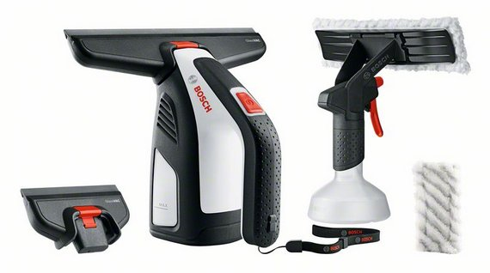
3. Continutul pachetului de produs
Package includes:
GlassVAC cu lamela de 266mm
Recipient spray cu tesatura de microfibra
Duza de aspirare cu lamele de 133 mm
Tesatura de microfibra aditionala
Manseta atasabila
Incarcator Charger
7
PT-HG/PXW | 21/09/2017
© Robert Bosch GmbH 2017. All rights reserved, also regarding any disposal, exploitation, reproduction, editing, distribution, as well as in the event of applications for industrial property rights.

Slide 8
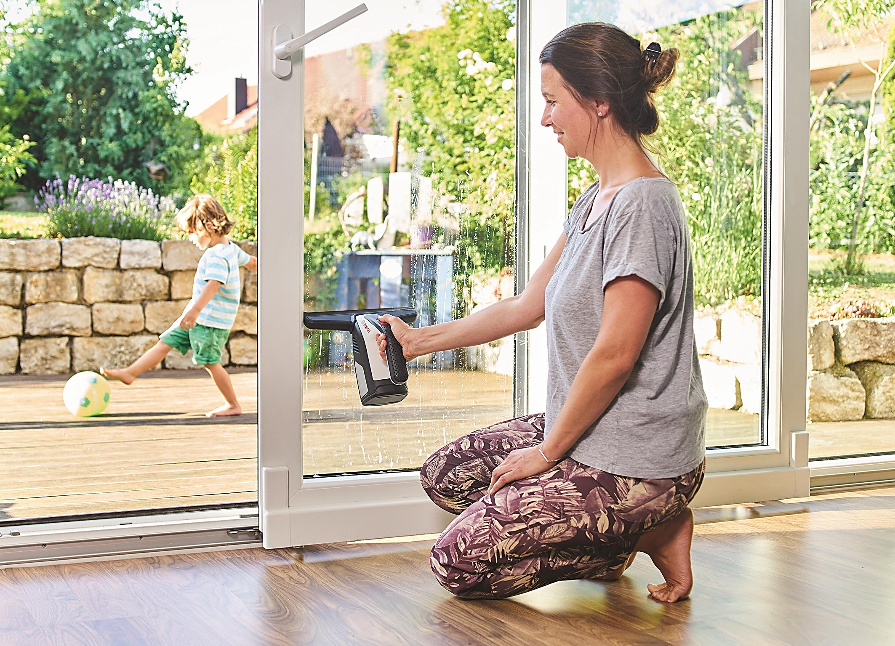
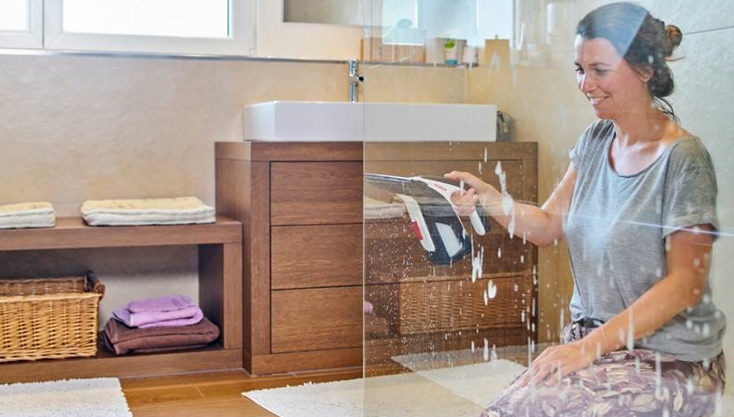
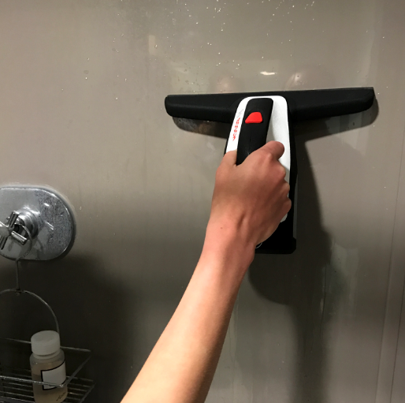
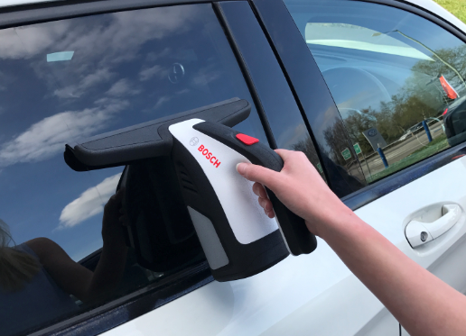
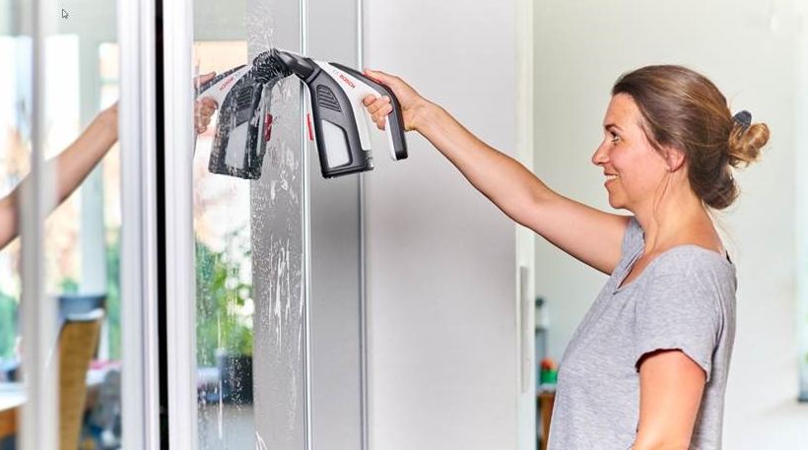
4. Recomandari de utilizare
Cabine de dus
Faianta
Ferestre
Parbrize
Oglinzi
8
PT-HG/PXW | 21/09/2017
© Robert Bosch GmbH 2017. All rights reserved, also regarding any disposal, exploitation, reproduction, editing, distribution, as well as in the event of applications for industrial property rights.

Slide 9
Multumim pentru atentie!

