Slide 1
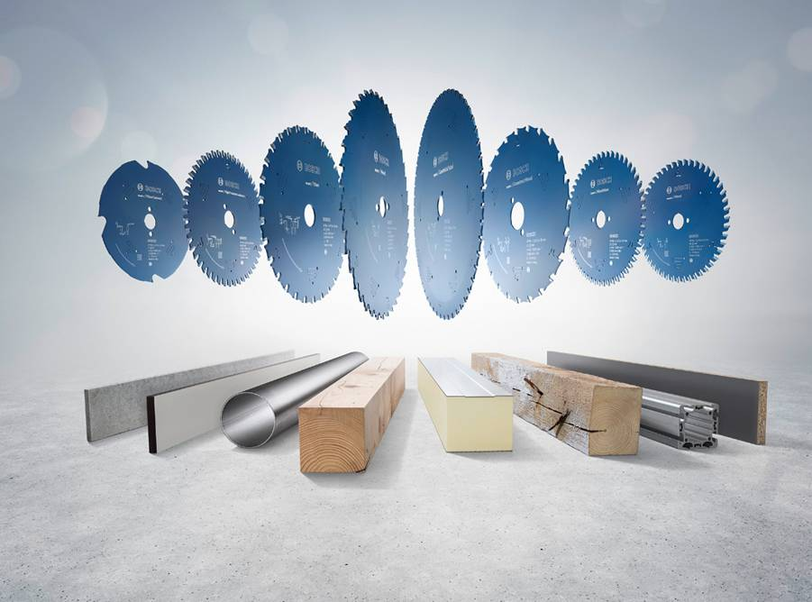

Expertii taierilor curate!
Bosch: Ne focusam pe calitate!
NOU! Inovatie de la Bosch:
Pelicula Proteqtion si dintii Microteq garanteaza taieri perfecte.
Internal | PT-AC/MKB1 | 23/05/2014 | © Robert Bosch GmbH 2013. All rights reserved, also regarding any disposal, exploitation, reproduction, editing, distribution, as well as in the event of applications for industrial property rights.

Slide 2




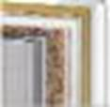




NOU! Panze pentru ferastraul circular Expert for
Sortimentul complet – privire de ansamblu
EXPERT | Material | Nr. repere | Diametru | Tip ferastrau circular
Wood | Lemn tare, lemn moale si material compozite | 109 | De la 120 la 450 mm | Ferastraie circulare / Ferastraie circulare de banc / Ferastraie circulare stationare / Ferastraie stationare cu sanie de glisare
Construct Wood | Lemn de constructii (cu insertii de cuie si resturi de beton), material compozite | 6 | De la 160 la 210 mm | Ferastraie circulare / Ferastraie circulare de banc
Laminated Panel | Materiale stratificate, acoperite cu strat de protectie pe una sau ambele fete | 10 | De la 140 la 350 mm | Ferastraie circulare / Ferastraie circulare de banc / Horizontal and vertical panel sizing saws / Ferastraie stationare cu sanie de glisare
High Pressure Laminate | Placi laminate HPL, Trespa© | 5 | De la 140 la 190 mm | Ferastraie circulare/ Ferastraie circulare de banc
Multimaterial | Materiale composite si placi laminate, aluminium si metale neferoase, plastic si lemn | 6 | De la 210 la 305 mm | Ferastraie circulare stationare si de banc
Aluminium | Aluminiu si metale neferoase | 28 | De la 140 la 315 mm | Ferastraie circulare / Ferastraie circulare de banc/ Ferastraie circulare stationare / Ferastraie stationare cu sanie de glisare
Steel | Otel | 10 | De la 160 la 355 mm | Ferastraie manuale / Ferastraie circulare stationare
Sandwich Panel | Panouri tip sandwich | 8 | De la 210 la 450 mm | Ferastraie circulare/ Ferastraie circulare de banc
Fiber Cement | Ciment cu fibre, gips-carton, corian, Eternit© | 6 | De la 140 la 190 mm | Ferastraie circulare / Ferastraie circulare de banc
Power Tools
Internal | PT-AC/MKP1-PA3 | 23/05/2014 | © Robert Bosch GmbH 2013. All rights reserved, also regarding any disposal, exploitation, reproduction, editing, distribution, as well as in the event of applications for industrial property rights.

Slide 3
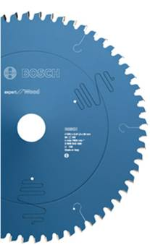



NOU! Panze pentru ferastraul circular Expert for
Expert for – beneficiile produsului
Dinti microteQ
Realizati din granule de carburi metalice extra dure – din productie proprie.
Pelicula ProteQtion
Pelicula realizata printr-o tehnologie avansata pentru obtinerea unor performante de taiere remarcabile. Previne coroziunea, reduce frecarea.
Fante antivibratie
Fante de dilatare realizate special pentru taieri uniforme, nivel de zgomot scazut si vibratii reduse.
Corp din otel
Taiat cu laser, realizat din otel foarte dur. Previne deformarea panzei si mareste precizia de taiere.
Inel de tensionare
Panzele isi pastreaza forma stabila pe toata durata de viata.
Fante de dilatare: Taiate cu laser pentru o stabilitate si o precizie crescuta a panzei. Asigura si un nivel redus de zgomot.
Power Tools
Internal | PT-AC/MKP1-PA3 | 23/05/2014 | © Robert Bosch GmbH 2013. All rights reserved, also regarding any disposal, exploitation, reproduction, editing, distribution, as well as in the event of applications for industrial property rights.

