Slide 1
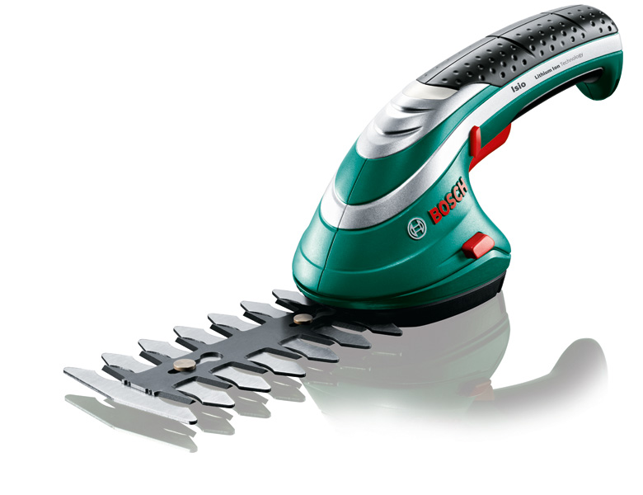
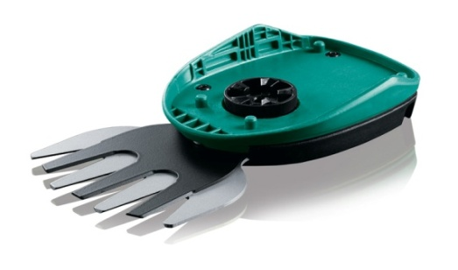
Noul Isio – Prietenul tau ideal de gradinarit
Isio
Strictly confidential | PT-LG/MKP | April 2013 | © Robert Bosch GmbH 2013. All rights reserved, also regarding any disposal, exploitation, reproduction, editing, distribution, as well as in the event of applications for industrial property rights.

Slide 2
Isio Generatia 3
Intelegere, Beneficii, Motive
Mesaj cheie:
“Prietenul tau ideal de gradinarit
Noul Isio, ajutorul multi-functional pentru
gradinaritul de zi cu zi.”
Gardinarii isi doresc... | Beneficii | Motive de ce
…versatilitate ridicata | Atasamente de tip ‘Multi-Click’ Pentru activitati esentiale de gradinarit | Noul sistem capsulat permite atasamentelor sa fie schimbate fara alte unelte Pentru taierea si stropirea gradinii
…unelte compacte & usoare | Forma si marime ideala pentru gradinaritul fara efort | Cantareste doar 500g (550g cu foarfeca de tuns arbusti) Cea mai mica unealta de gradina construita sa se muleze special pe mana
…unelte puternice | Taieri neintrerupte Pentru actiune puternica si fara pierderi de timp | Baterie de 1.5 Ah cu celule litium-ion Sistemul anti-Blocking asigura taieri continue fara intreruperi sau timp pierdut
Strictly confidential | PT-LG/MKP | April 2013 | © Robert Bosch GmbH 2013. All rights reserved, also regarding any disposal, exploitation, reproduction, editing, distribution, as well as in the event of applications for industrial property rights.

Slide 3
Isio Generatia 3
Caracteristici principale
1
Softgrip confortabil
Suprafata aderenta si ergonomica, pe ambele parti
5
Timp de lucru pana la 50 min
Baterie integrata litium-ion de 3.6 V
2
Indicator al statusului bateriei
4-faze de display ale LED-ului ce indica statusul bateriei
Ergonomie perfecta
Mica, usoara, compacta, cantareste max. 550g
6
3
Sistem ‘Anti-Blocare’
Actiune puternica,
Fara timp pierdut
7
Sistem ‘Multi-Click’
Face ca schimbarea atasamentelor sa fie si mai usoara
4
Concept Multitool
O unitate de putere + noi atasamente = noi utilizari
Strictly confidential | PT-LG/MKP | April 2013 | © Robert Bosch GmbH 2013. All rights reserved, also regarding any disposal, exploitation, reproduction, editing, distribution, as well as in the event of applications for industrial property rights.

Slide 4
Isio Generatia 3
Isio generatia 3
UNIC
Cea mai compacta si versatila unealta de tuns iarba & arbustii
Top argumente de vanzare
Versatilitate cu o noua gama de atasamente de tip “Multi-Click’
Compact, usor si puternic pentru gradinaritul fara efort
Taieri neintrerupte datorita bateriei Litium-Ion si a sistemului ‘Anti-blocare’
 | Isio
Lungimea lamei / latimea | 12cm / 8cm
Sistem capsulat | Da
Greutate | 550g (max)
Noul Isio, ajutorul multi-functional pentru gradinaritul de zi cu zi.
*please refer to country pricelists for local pricing
Strictly confidential | PT-LG/MKP | April 2013 | © Robert Bosch GmbH 2013. All rights reserved, also regarding any disposal, exploitation, reproduction, editing, distribution, as well as in the event of applications for industrial property rights.

Slide 5
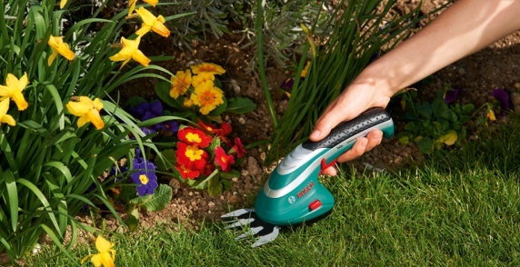
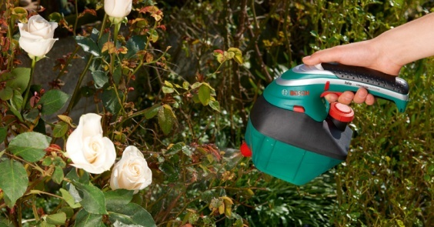
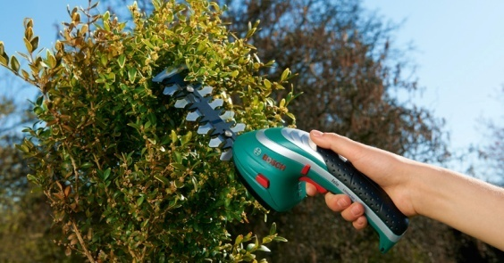
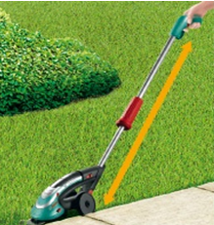
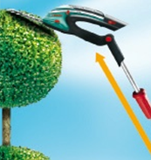
Generatia multi-functionala Isio 3
Isio Generatia 3
1st USP
Foarfeca de iarba
Pulverizator
Foarfece pentru tuns arbusti
Maner telescopic
Si mai multe urmeaza....
Ajutorul multi-functional pentru gradinaritul de zi-cu-zi
Strictly confidential | PT/LG | April 2013 | © Robert Bosch GmbH 2013. All rights reserved, also regarding any disposal, exploitation, reproduction, editing, distribution, as well as in the event of applications for industrial property rights.

Slide 6
Generatia Isio 3 – cea mai buna flexibilitate din gama
Isio Generatia 3
2nd USP
Marimea produsului (volumul in ml)
“Cautam asa ceva de multa vreme” ¹⁾
570
-15%
490
“Marimea se potriveste perfect” ¹⁾
Isio 2
Isio 3
1) Sursa: concept acceptance test 2011
Gradinarit fara efort - compact, usor si puternic
Strictly confidential | PT/LG | April 2013 | © Robert Bosch GmbH 2013. All rights reserved, also regarding any disposal, exploitation, reproduction, editing, distribution, as well as in the event of applications for industrial property rights.
Notes:
Optimierter Grifumfang

Slide 7
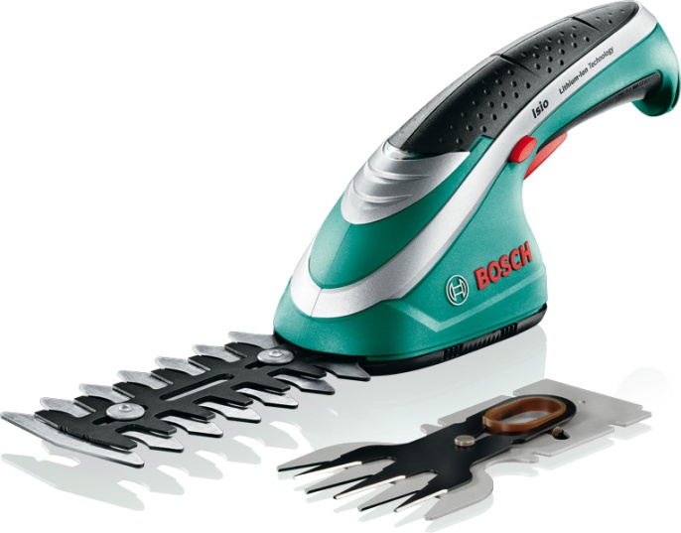
Isio Generatia 3
Diferentele majore: Isio Gen. 2 vs. Isio Gen. 3
Noul sistem capsulat “Multi-Click”
Nou pulverizator atasat “Multi-Click"
Maner telescopic utilizabil atat la iarba cat si la arbusti
Dimensiuni mai mici si mult mai compact
Ambalaj soft in loc de cutia metalica
Strictly confidential | PT-LG/MKP | April 2013 | © Robert Bosch GmbH 2013. All rights reserved, also regarding any disposal, exploitation, reproduction, editing, distribution, as well as in the event of applications for industrial property rights.

Slide 8
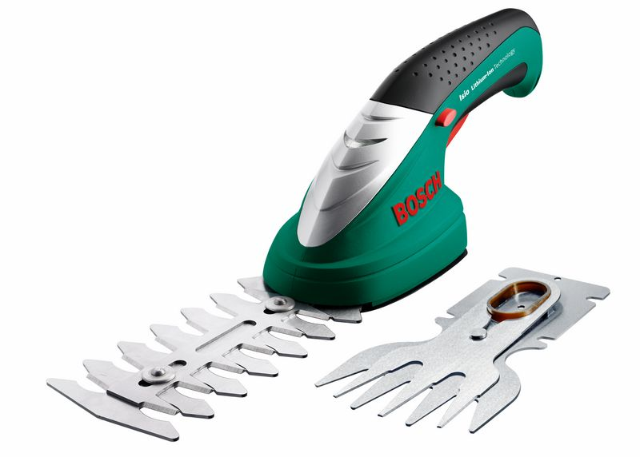
Isio Generatia 3
Diferentele majore : Isio Gen. 1 (AP) vs. Isio Gen. 3
Noul sistem capsulat “Multi-Click”
Noul pulverizator atasat “Multi-Click"
Maner telescopic utilizabil atat la iarba cat si la arbusti
Dimensiuni mai mici si mult mai compact
Ambalaj soft in loc de cutie metalica
25% mai mult timp de functionare
Incarcare mai rapida, de la 5h la doar 3.5h
Sistem Anti-Blocare
Strictly confidential | PT-LG/MKP | April 2013 | © Robert Bosch GmbH 2013. All rights reserved, also regarding any disposal, exploitation, reproduction, editing, distribution, as well as in the event of applications for industrial property rights.

Slide 9
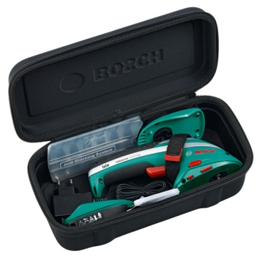
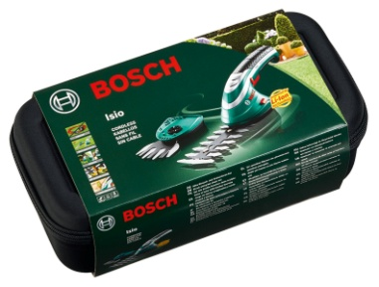
Isio Generatia 3
Date tehnice Isio
 | Isio
Tip baterie / Putere | Li-Ion / 3.6 V
Capacitatea bateriei | 1.5Ah
Timp de incarcare max. | 3.5 h
Timp de functionare | Pana la 50 min
Sistem Anti Blocare | Da
Lungime lama arbusti | 12cm
Deschidere dinti | 8mm
Latimea lamei de iarba | 8cm
Capacitate rezervor pulverizator | 1 litre
Maner telescopic cu ajustare a lungimii | 80-115cm
Sistem capsulat ‘Multi-Click’ | Da
Softgrip | Da
Baterii interschimbabile | Nu
Indicator al puterii de rezerva | Da
Greutate (cu baterie) | Max 550g
Setul de livrare
Unealta Isio fara acumulator
Cutie din material moale
Lama foarfeca pentru tuns iarba– (in functie de varianta)
Lama foarfeca pentru tuns arbusti– (in functie de varianta)
Maner telescopic – (in functie de varianta)
Incarcator
Manual de utilizare
Strictly confidential | PT-LG/MKP | April 2013 | © Robert Bosch GmbH 2013. All rights reserved, also regarding any disposal, exploitation, reproduction, editing, distribution, as well as in the event of applications for industrial property rights.

Slide 10
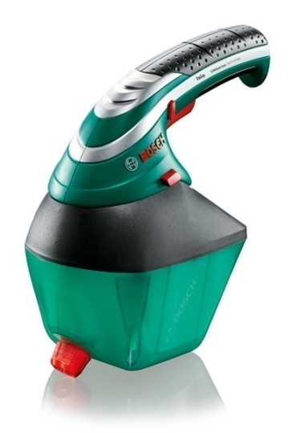
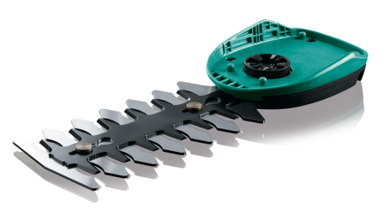
Isio Generatia 3
Accesorii 2014
Cod produs | Cod EAN | Descriere produs | Ambalaj
F 016 800 326 | 3165140.697170 | Atasament foarfeca iarba ISIO | Blister
F 016 800 327 | 3165140.697187 | Atasament foarfeca pentru tuns arbustiISIO | Blister
F 016 800 329 | 3165140.697200 | Maner telescopic ISIO | Cutie de carton tip steag
F 016 800 330 | 3165140.697217 | Pulverizator atasat ISIO | Cutie de carton
Strictly confidential | PT-LG/MKP | April 2013 | © Robert Bosch GmbH 2013. All rights reserved, also regarding any disposal, exploitation, reproduction, editing, distribution, as well as in the event of applications for industrial property rights.

Slide 11
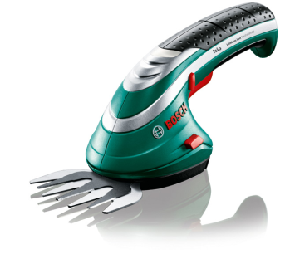
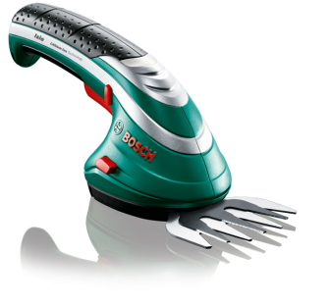
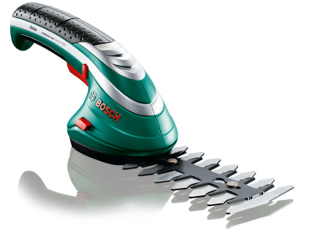
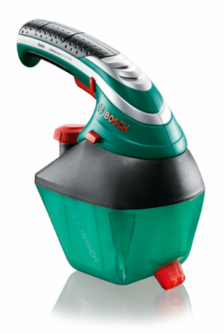
Isio Generatia 3
Imagini ale produsului
Imagine 118917
Imagine 118918
Imagine 118926
Imagine 118916
Imagine 118919
Imagine 118920
Imagine 118925
Imagine 118923
Strictly confidential | PT-LG/MKP | April 2013 | © Robert Bosch GmbH 2013. All rights reserved, also regarding any disposal, exploitation, reproduction, editing, distribution, as well as in the event of applications for industrial property rights.

Slide 12
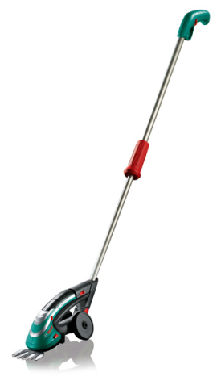
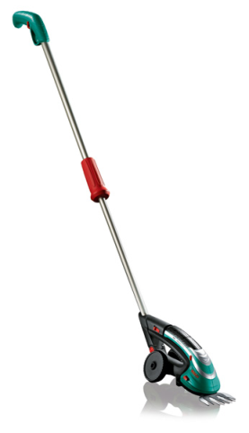
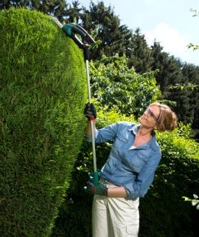
Isio Generatia 3
Imagini ale produsului
Imagine 118921
Imagine 118922
Imagine 118924
Imagine 139698
Imagine 139692
Imagine 139695
Mai multe imagini in picture pool…
Strictly confidential | PT-LG/MKP | April 2013 | © Robert Bosch GmbH 2013. All rights reserved, also regarding any disposal, exploitation, reproduction, editing, distribution, as well as in the event of applications for industrial property rights.

Slide 13
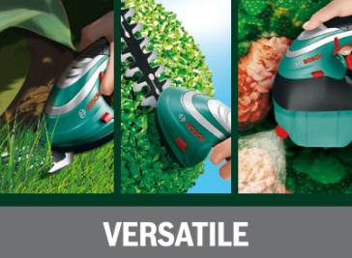
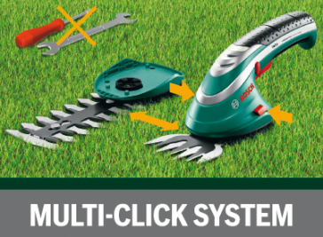
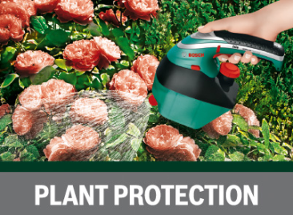
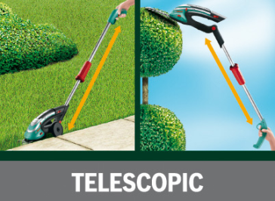
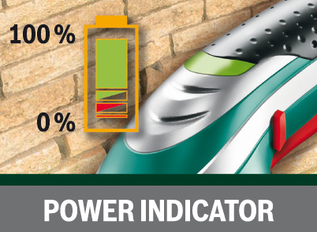
Isio Generatia 3
Imagini ambalaj
Imagine 118912
Imagine 118913
Imagine 118914
Imagine 118911
Imagine 118910
Strictly confidential | PT-LG/MKP | April 2013 | © Robert Bosch GmbH 2013. All rights reserved, also regarding any disposal, exploitation, reproduction, editing, distribution, as well as in the event of applications for industrial property rights.

